Slide 1
UNIT IV

Slide 2
Syllabus:
Normalization:
Introduction to Schema Refinement - Problems Caused By Redundancy
Decomposition
Functional Dependency
Clousre of a set of FD’s
Normal Forms (First, Second, Third normal forms, BCNF, Fourth & Fifth normal forms).

Slide 3
Introduction
✓ Normalization is an essential part of database design.
✓ Normalization is also known as “Schema Refinement” in database design.
✓ The Schema Refinement divides larger tables to smaller tables and links them using relationships.
✓ Normalization is a “process of organizing the data in database to avoid data redundancy, insertion anomaly, update anomaly & deletion anomaly”.

Slide 4
Normalization means “split the tables into small tables which will contain less number of attributes in such a way that table design must not contain any problem of inserting, deleting, updating anomalies and guarantees no redundancy”.
✓ A good understating of the semantics of data helps the designer to build efficient design using the concept of normalization.

Slide 5
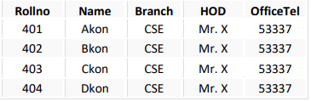
✓ Problems Without Normalization:
If tables not properly normalized and have data redundancy then it will not only eat up extra memory space but will also make it difficult to handle and update the database, without facing data loss.
Insertion, Updating and Deletion Anomalies are very frequent if database is not normalized.
To understand these anomalies let us take an example of a Student table.

Slide 6
From the table above, we have data of 4 Computer Sci. students. As we can see, data for the field’s Branch, HOD and OfficeTel is repeated for the students who are in the same branch in the college, this is Data Redundancy.
➔ Finally there are three types of Update anomalies or problems without Normalization:
1.Insertion Anomaly: Suppose for a new admission, until and unless a student opts for a branch, data of the student cannot be inserted, or else we will have to set the branch information as NULL. This is known as Insertion anomaly.
2.Deletion Anomaly: In our Student table, two different information systems are kept together, Student information and Branch information. Hence, at the end of the academic year, if student records are deleted, we will also lose the branch information. This is known as Deletion anomaly.

Slide 7
3.Update Anomaly: What if Mr. X leaves the college? Or is no longer the HOD of computer science department? In that case all the student records will have to be updated, and if by mistake we miss any record, it will lead to data inconsistency. This is known as Update anomaly.

Slide 8
➢Functional Dependency (FD):
✓ Functional Dependencies are fundamental to the process of Normalization i.e., Functional Dependency plays key role in differentiating good database design from bad database designs.
✓ A functional dependency is a “type of constraint that is a generalization of the notation of the key”.
✓ Functional Dependency describes the relationship between attributes (columns) in a table.
✓ Functional dependency is represented by an arrow sign (→).

Slide 9

In other words, a dependency FD: “X → Y” means that the values of Y are determined by the values of X. Two tuples sharing the same values of X will necessarily have the same values of Y. An attribute on left hand side is known as “Determinant”. Here X is a Determinant.

Slide 10
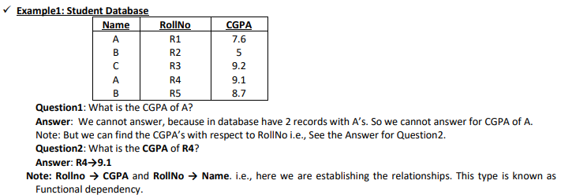

Slide 11
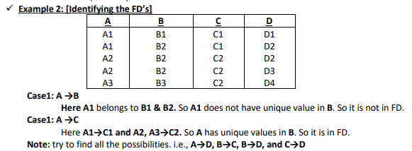

Slide 12
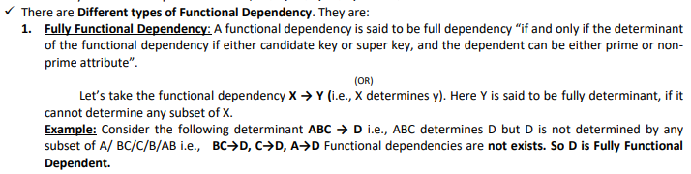

Slide 13
Partial Functional Dependency: If a non-prime attribute of the relation is getting derived by only a part of the candidate key, then such dependency is known as Partial Dependency.
(OR)
In a relation having more than one key field, a subset of non key fields may depend on all key fields but another subset or a particular non-key field may depend on only one of the key fields.
Such dependency is defined as Partial Dependency.

Slide 14
Example: Consider the following determinants AC→P, A→D, D→P. From these determinants P is not fully FD on AC.
Because, If we find A + (means A’s Closure) A→D, D→P i.e., A→P.
But we don’t have any requirement of C.
C attribute is removed completely.
So P is Partially Dependent on AC

Slide 15
Transitive Functional Dependency: If a non-prime attribute of a relation is getting derived by either another nonprime attribute or the combination of the part of the candidate key along with non-prime attribute, then such dependency is defined as Transitive dependency.
i.e., in a relation, there may be dependency among non-key fields.
Such dependency is called Transitive Functional Dependency. Example: X→Y, and Y→Z then we can determine X→Z holds.

Slide 16
Trivial Functional Dependency: It is basically related to Reflexive rule. i.e., if X is a set of attributes, and Y is subset of X then X→Y holds.
Example: ABC→BC is a Trivial Dependency
Multi-Valued Dependency: Consider 3 fields X, Y, and Z in a relation. If for each value of X, there is a well-defined set of values Y and Well-defined set of values of Z and set of values of Y is independent of the set values of Z.
This dependency is Multi-valued Dependency. i.e., X →Y / Z.

Slide 17
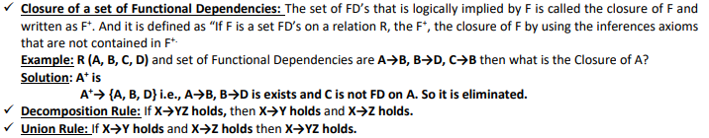

Slide 18
Database Keys: They are used to establish and identify the relation between tables. They can also ensure that each record within a table can be uniquely identified by combination of one or more fields with in a table.
Super Key: An attribute or the combination of attributes is defined as the super key if they derive all attributes of the relation. Super key is defined as the set of attributes with in a relation that uniquely identify each record in a table.
Candidate Key: An attribute or the combination of the attributes is defined as the candidate key. They derive all the attribute of the relation. They are minimum level of subset.
Prime or Key Attribute: The attributes of the relation which exists as path of any possible candidate key is called Prime or key attribute.

Slide 19
4. Primary key: It is a candidate key that is most appropriate to become the main key of the table. It is the key uniquely identifies the records in a table.
5. Composite Key: A key that consists o0f two or more attributes that uniquely identifies an entity occurrence is called composite key.
6. Secondary Key or Alternative key: The candidate keys which are not selected for primary key are known as secondary key.
7. Foreign Key: Tuples in one relation, say r1 (R1) often need to refer tuples in another relation, say r2 (R2).

Slide 20
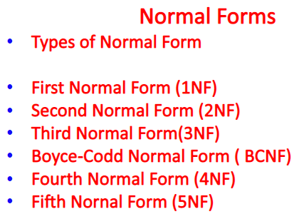

Slide 21
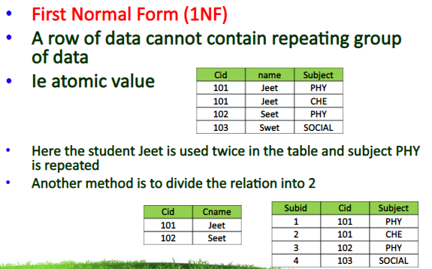

Slide 22
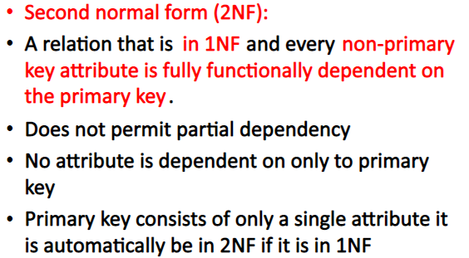

Slide 23
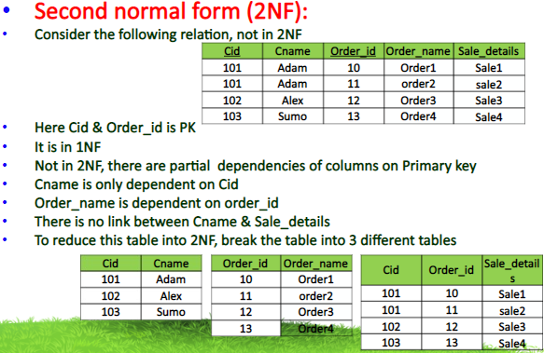

Slide 24
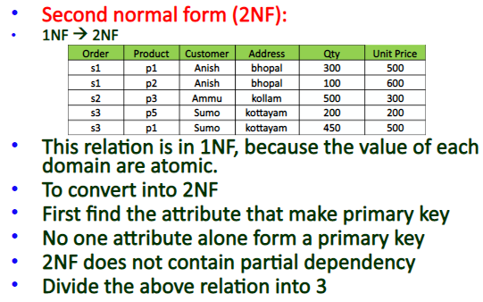

Slide 25
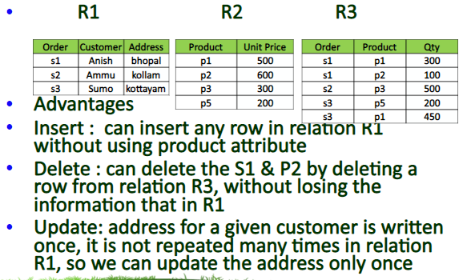

Slide 26
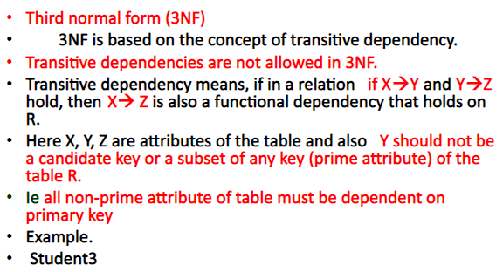

Slide 27
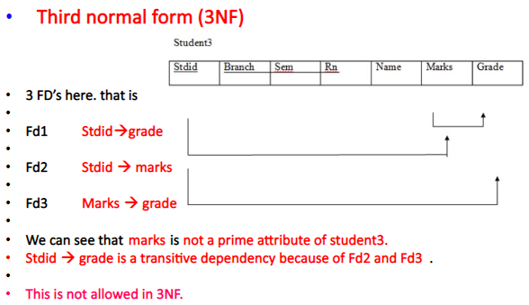

Slide 28
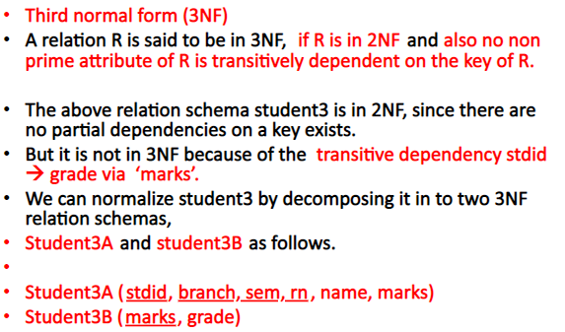

Slide 29
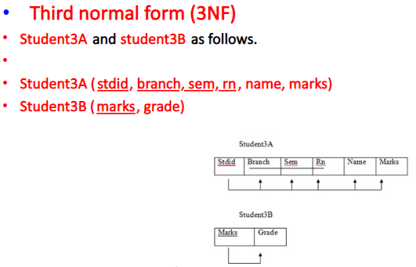

Slide 30
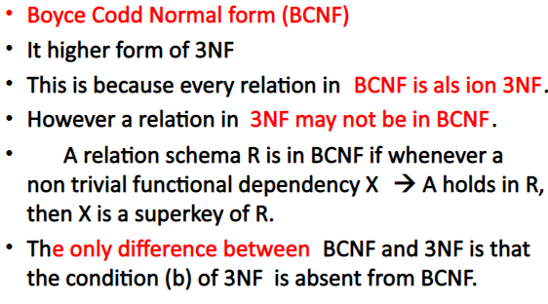

Slide 31
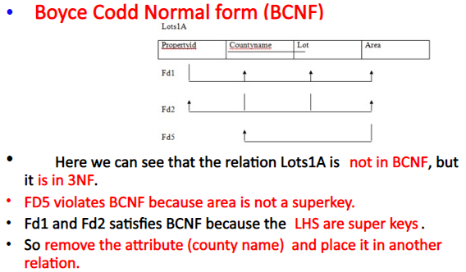

Slide 32
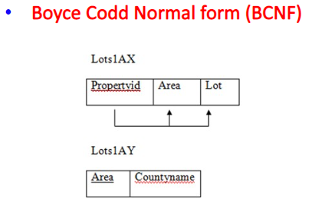

Slide 33
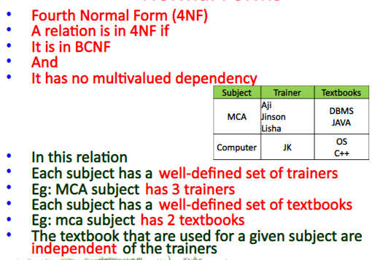

Slide 34
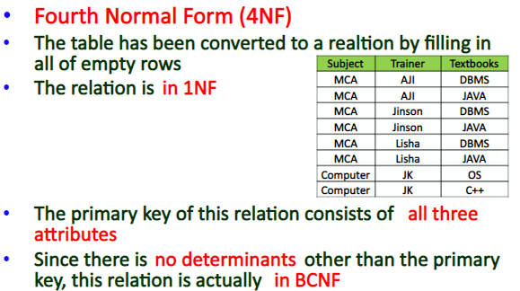

Slide 35
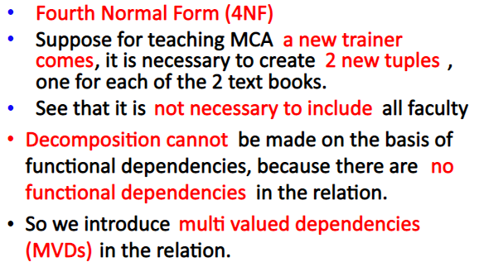

Slide 36
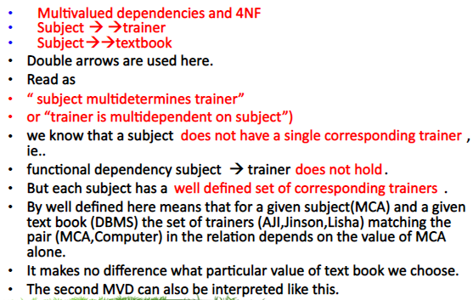

Slide 37
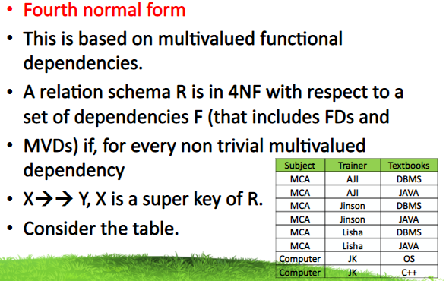

Slide 38
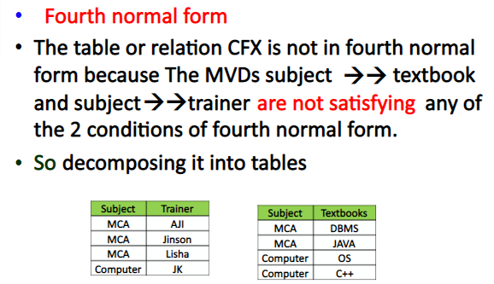

Slide 39
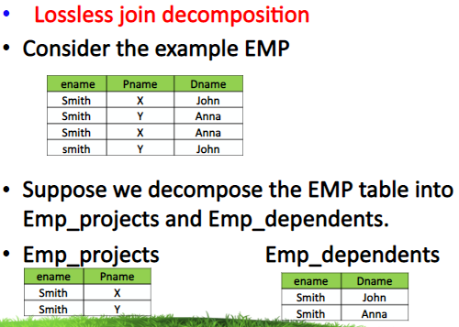

Slide 40
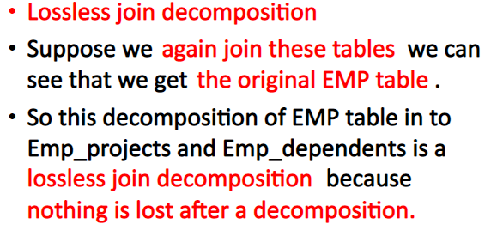

Slide 41
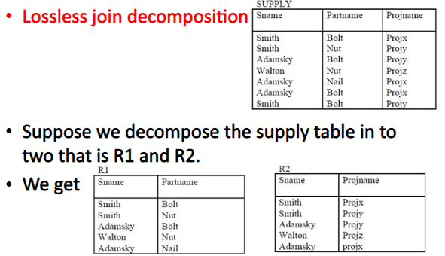

Slide 42
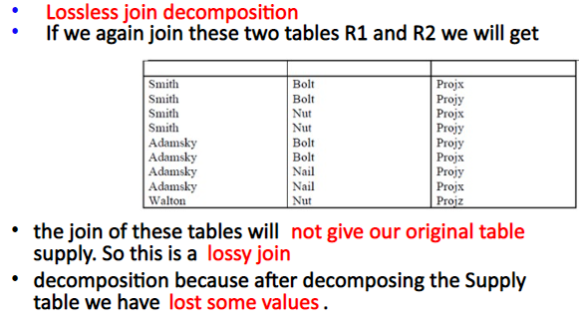

Slide 43
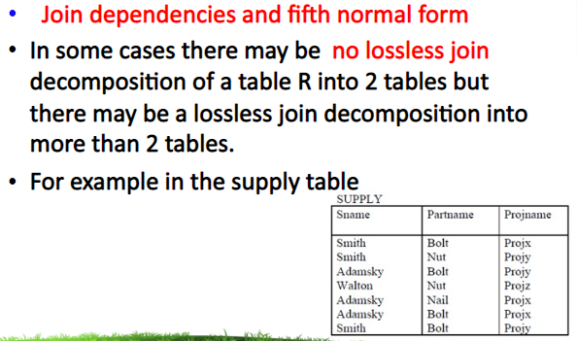

Slide 44
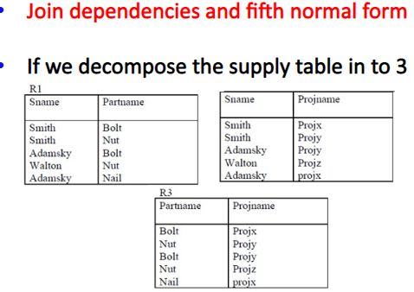

Slide 45
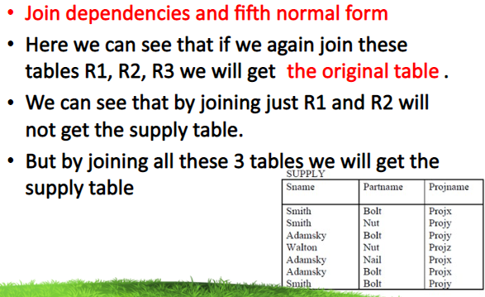

Slide 46
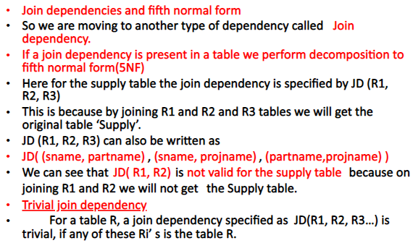

Slide 47
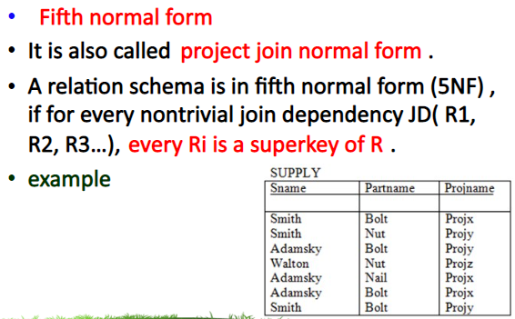

Slide 48
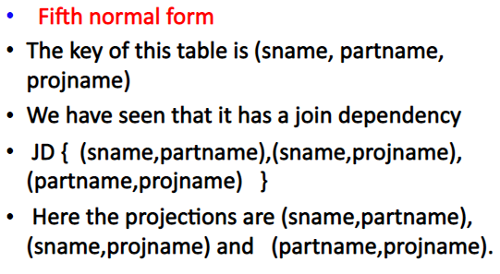

Slide 49
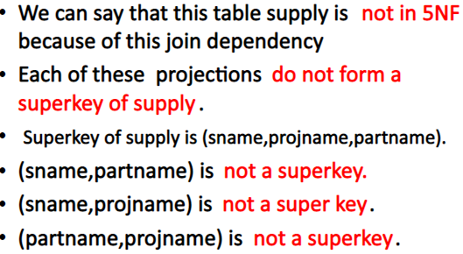

Slide 50
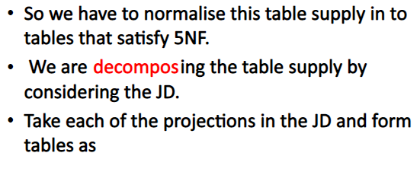

Slide 51
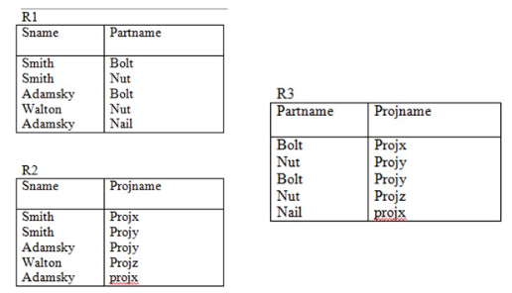

Slide 52
